Slide 1

Sprint-1 McDonald’s

Slide 2
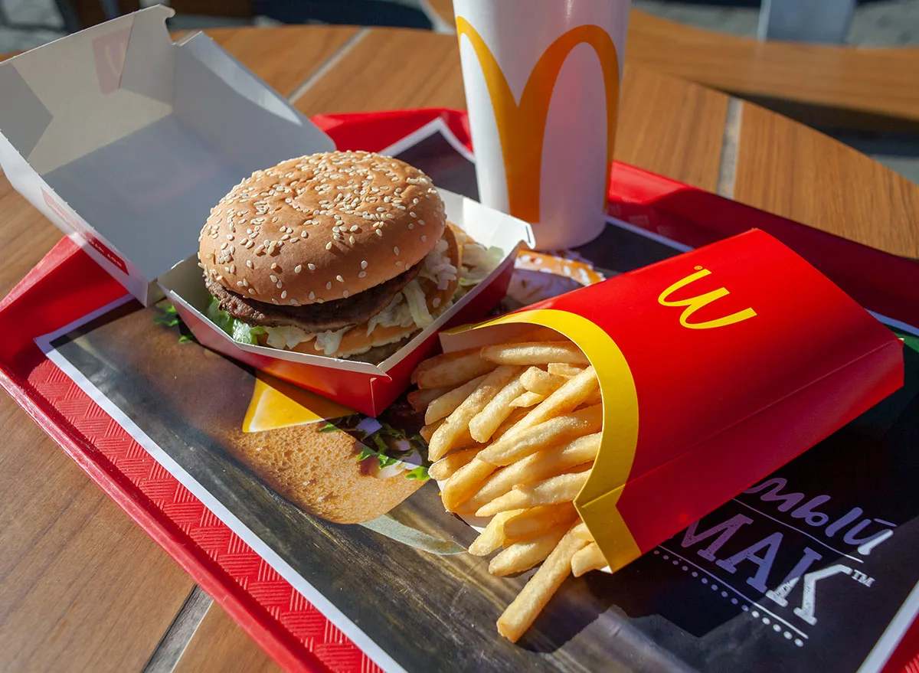

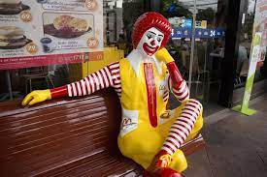
Introduction
McDonald's Corporation is an American-based multinational fast-food chain, founded in 1940 as a restaurant operated by Richard and Maurice McDonald, in San Bernardino, California, United States.

Slide 3
Prasath
Login
Samiran
Play store Icon
Module Name
Module Assigned
Location
Mohit
Customization
Rahul
Search
Prerna
Cart
Sagar

Slide 4
Personal Contribution
He make a group in JIRA and invite team member.
He checks Status Update.
He checks that everyone issue is link with epic.
Mohit
Rahul
Sagar
Prerna
Prasath
Samiran
He checkout every person has their respective assign module.
She created a Dashboard for our Sprint.
He makes PowerPoint Presentation.

Slide 5
Challenges Faced
Overcome the Challenges
Adapting to Changes in Agile Project
Difficulty to learn New components
Difficulty to Understand New Process
Decision making can be delayed since diff. opinion of Participants
Lack of empathy
Style of work is different for everybody
To Understand the TOPIC completely.
Our Mentor helps a lot.
We increase knowledge sharing within the team.
We distributed module to everyone within the team.
We set a timeline to complete each task.
We learn about Jira software on online.

Slide 6
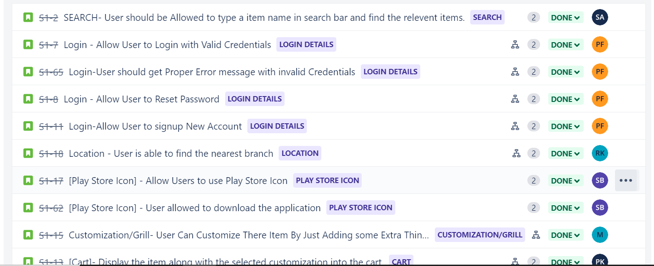
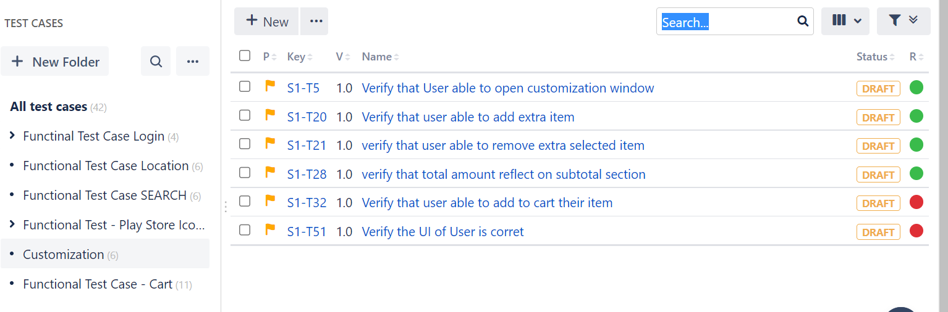
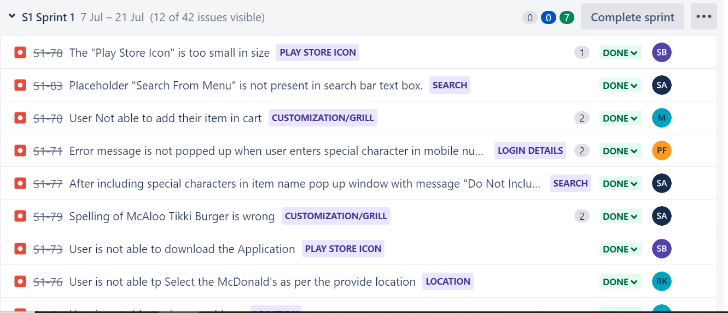
LEARNINGS
USER STORIES
TEST CASES
BUG/DEFECT
It is smallest unit of work in agile Framework.
It is a format for software testing required to check if a particular application/module is working or not.
Defect is when a product backlog item does not meet acceptance criteria.

Slide 7
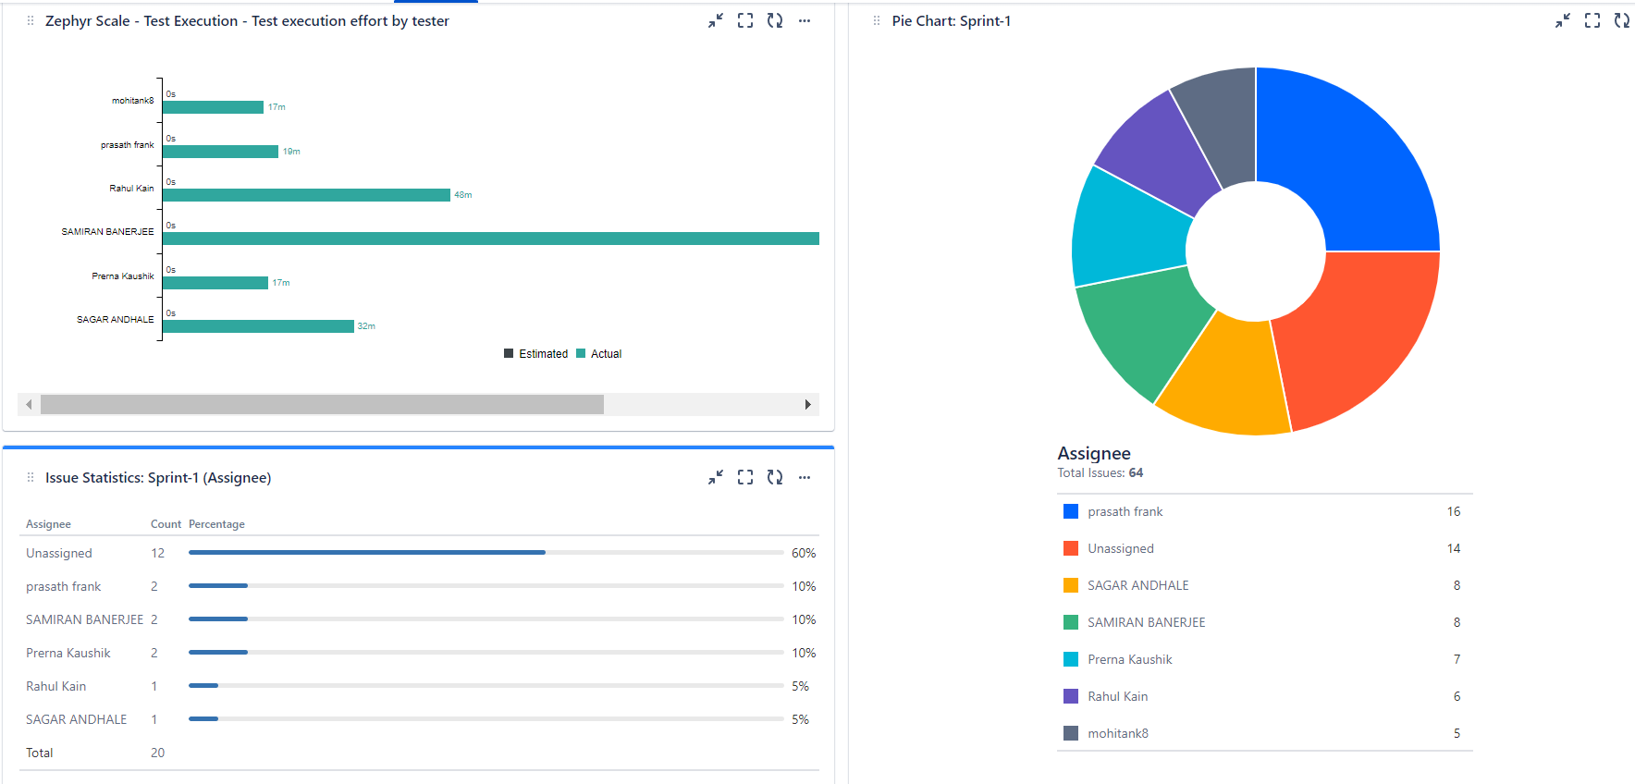
Dashboard
Added Plugin:-
Pie Chart
Issue Statistic
Zephyr Score
Average age chart
Assign to me

Slide 8
Learnings From JIRA Tool
User Story Creation
Epic Creation
Working with Zephyr Scale
Test Case Creation
Test Cycle Creation
Test Execution
Traceability Matrix
Dashboard Creation

Slide 9
Sprint Summary
Module | User Stories | Tasks | Test Cases | Bug/Defects | Assign
Login | 4 | 8 | 5 | 2 | Prasath
Search | 1 | 2 | 6 | 2 | Sagar
Play store Icon | 2 | 4 | 9 | 2 | Samiran
Location | 1 | 2 | 6 | 2 | Rahul
Customization | 1 | 2 | 6 | 2 | Mohit
Cart | 1 | 2 | 11 | 2 | Prerna

Slide 10
Links
Github: https://github.com/Prernak29/McDonald-s
JIRA : https://mohitank.atlassian.net/jira/software/projects/S1/boards/3

Slide 11

Thank you
Prerna Kaushik
Sagar Andhale
Rahul Kain
Mohit Tank
Prasath
Samiran Banerjee
Batch : Capgemini-73-Testing-B5-Api

